Slide 1
CES Integrated Digital Cockpit Demo
Proposed Development Plan

Slide 2

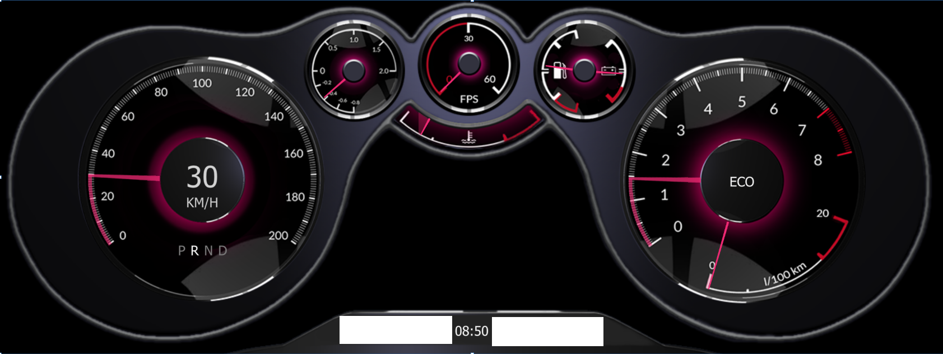
Digital Cockpit Architecture – Full Details
IVI Content graphics plane
Safety critical graphics plane
Non safety critical graphics plane
IVI UI
Cluster UI
ASIL-B
There is a 3rd video layer needed by the cluster screen and that is for functional safety. The Qt Safe Renderer draws the safety critical part that includes the telltales and is largely transparent as illustrated by the dark blue outlined layer. The non-safety critical dials and other driver specific information is also drawn by the ASIL domain as illustrated by the green outlined layer.
Portions of the non-safety layer are transparent to allow the IVI functionality to be displayed in the case where there is a 3rd plane underneath for the IVI layer that spans all displays.
A complication is that there could be different cluster modes where the size of the dials change and with it the area available to the IVI content. This implies a communication channel between the IVI and cluster domains to signal these configuration changes.
There should be a fallback cluster configuration in the event the IVI domain fails.
Tell-tales
Qt
Qt
Qt Safe Renderer
OS / Linux
ASIL-D RTOS
Type 1 Hypervisor (SC)
SoC

Slide 3
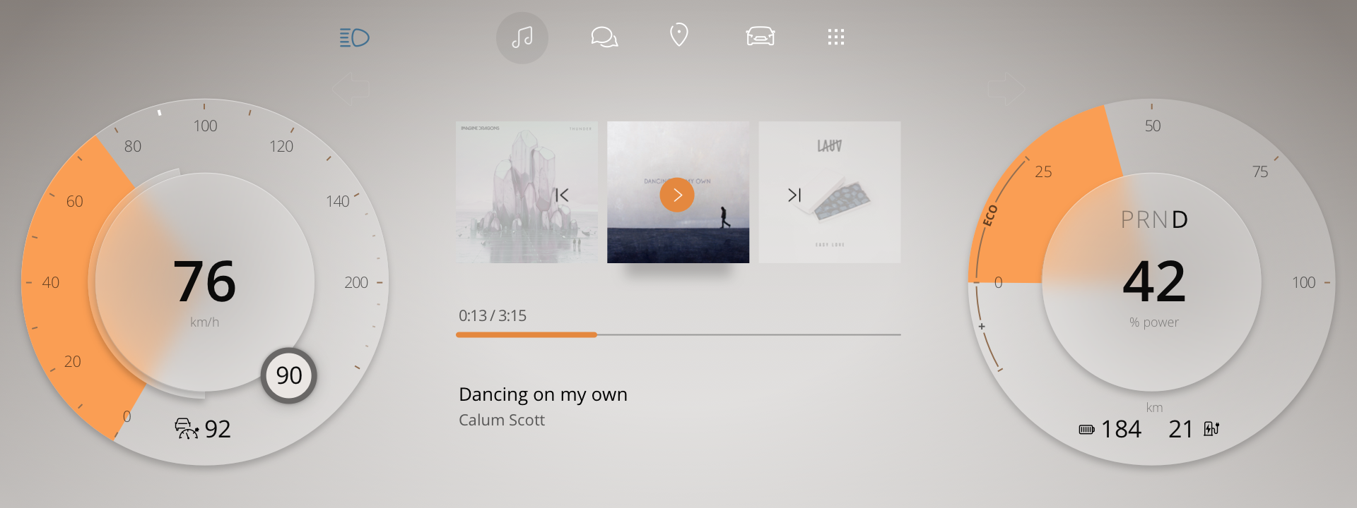
Step 1: Desktop Development
Develop this screen with telltales using the Qt Safe Renderer Tooling
Provide input for
speed
speed limit value (comes from navigation system we hope)
electric power use
drive train status (PRND)
Tell tales (actual ones TBD – Johan?)

Slide 4
Step 1: Tasks and missing details
Need to know tell-tale design – Johan?
Nice to have 3D design input to create needles. Even better if can use Qt 3D Studio. Ask Sami.
Design API for getting data into the cluster. Work with Kalle’s team. Timo is working on this. See https://bugreports.qt.io/browse/QTPM-928, https://bugreports.qt.io/browse/QTAUTO-570

Slide 5
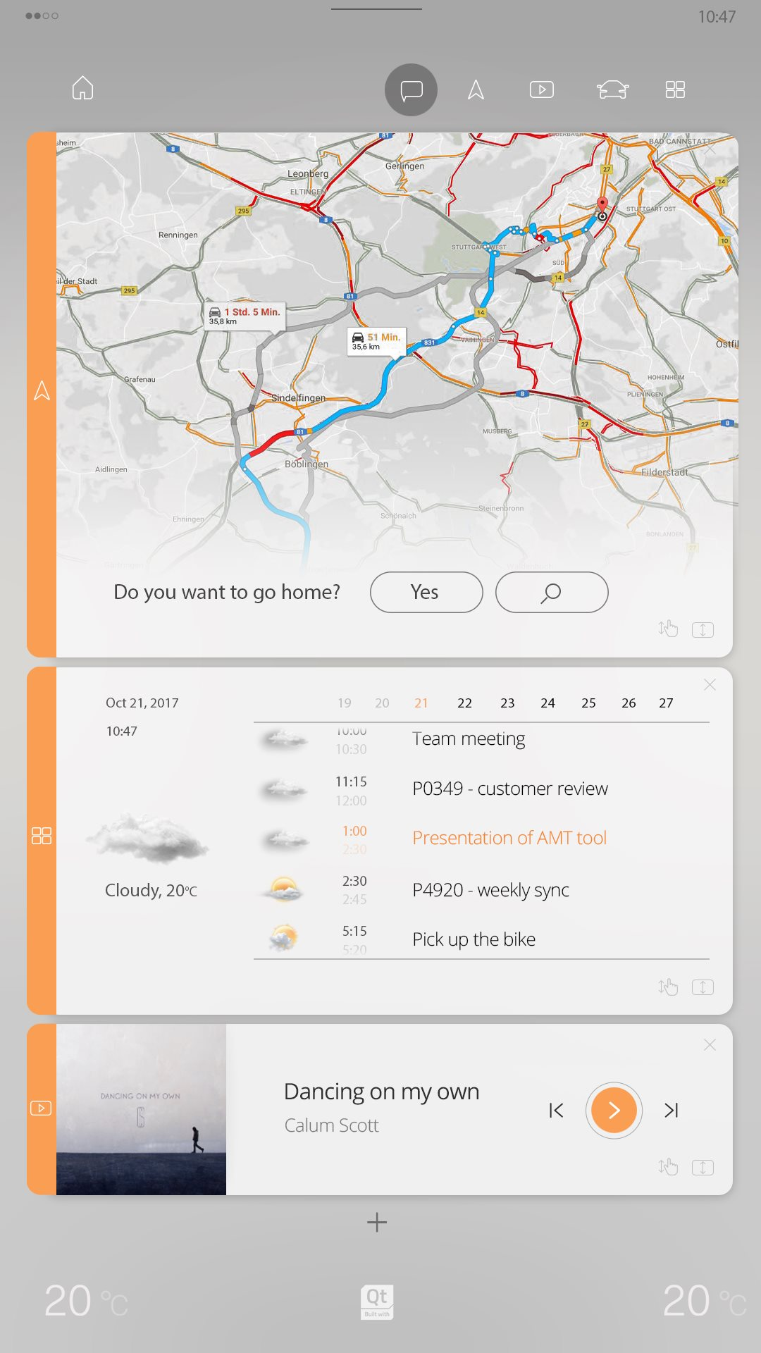
Step 2: Intermediate Architecture
Cluster UI
IVI UI
Linux
SoC
Build on Intel NUC
Cluster in independent process, rendering to separate layer
IVI graphics layer is below cluster layer
Layers composited by the graphics hardware

Slide 6
Step 2: Tasks
Get the IVI code from Luxoft and get running on the NUC
Luxoft owns the IVI code. To be investigated is if we can help on some apps, e.g. car status
Figure out how to configure graphics layers on the NUC
Run the Cluster as a separate process displaying on another graphics layer than IVI

Slide 7
Step 3: Final CES Architecture
Cluster UI
QSR
IVI UI
INTEGRITY
Linux
GHS Multivisor
Renesas H3
Multivisor
SoC

Slide 8
Step 3: Tasks
Requires Kalle’s team to get Qt running on the INTEGRITY T17 and integrated with Renesas software package
https://bugreports.qt.io/browse/QTPM-767
https://bugreports.qt.io/browse/QTPM-869
Assume no help from Luxoft in this part

